Slide 1
The One Where We Make It To The Top
Happy Residents, Renewals & The Summit
https://www.youtube.com/watch?v=q-9kPks0IfE

Slide 2
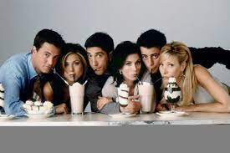
Mission Statement
Our mission is to create an exceptional living experience that leaves our residents overwhelmingly happy. We strive for excellence by consistently going above and beyond to be remembered, making a positive impact in the lives of our residents. Our commitment extends to achieving high lease renewal rates and maintaining 100% occupancy through our unwavering dedication to exceptional service. We aim to differentiate ourselves as the preferred choice for residents, leaving an unforgettable impression that sets us apart in the industry.

Slide 3
Tell us…..
Name, and property you’re from
How were YOU there for a resident?

Slide 4
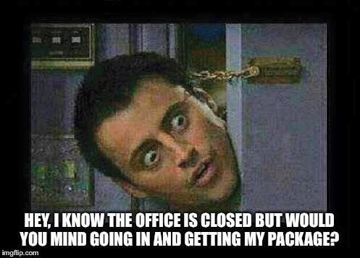
PIVOT!
https://www.youtube.com/watch?v=8w3wmQAMoxQ
Sometimes, when things aren’t going the way we expected or if we find something new/ better, WE need to be able to PIVOT!

Slide 5
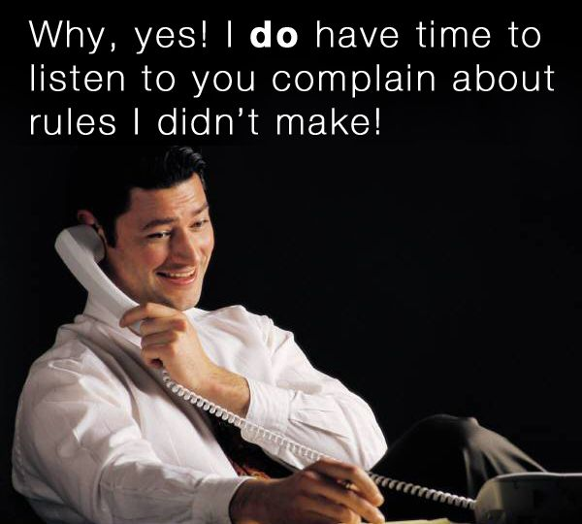
Happy Residents!

Slide 6
What does happy residents mean to you?
And How Can happy residents positively impact the community?

Slide 7
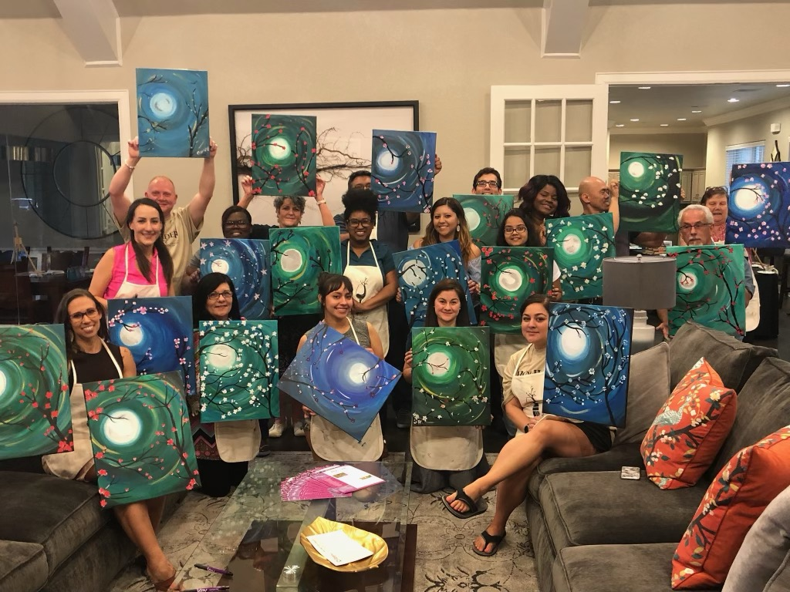
What have you done to follow the happy resident Philosophy?

Slide 8
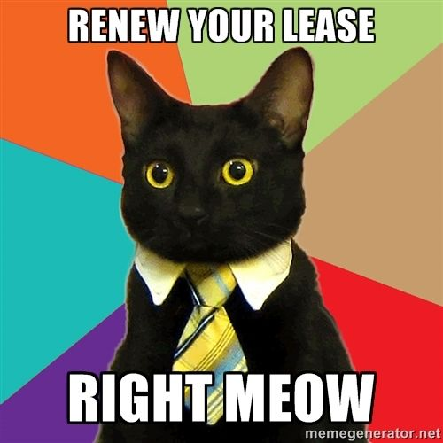
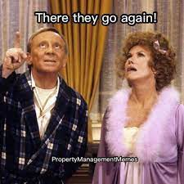
What are some challenges you have faced and how did you make all parties happy?

Slide 9
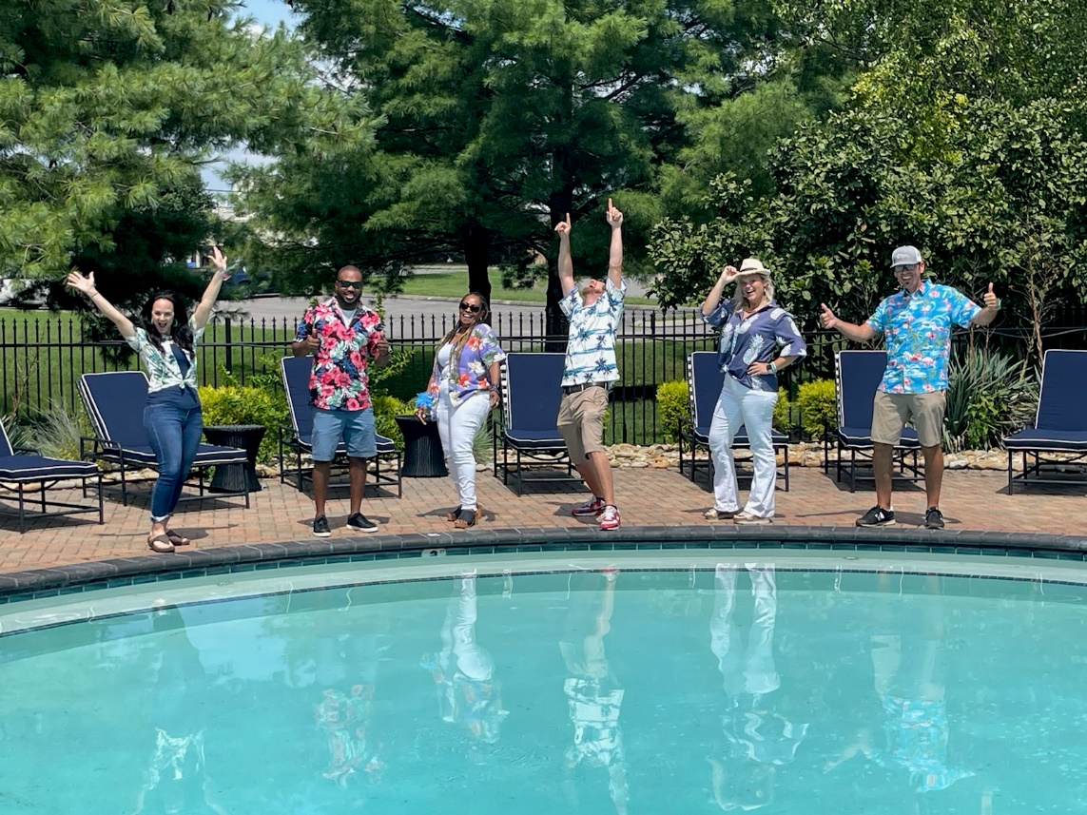
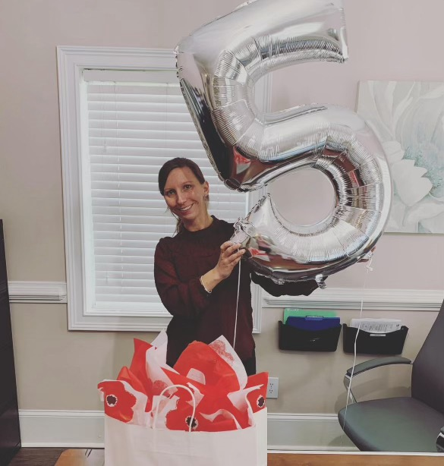
Resident Questionnaires and happy teams
A good questionnaire score is not possible without Happy Residents! ☺
Happy Residents starts with……
Celebrating 5 Years!

Slide 10
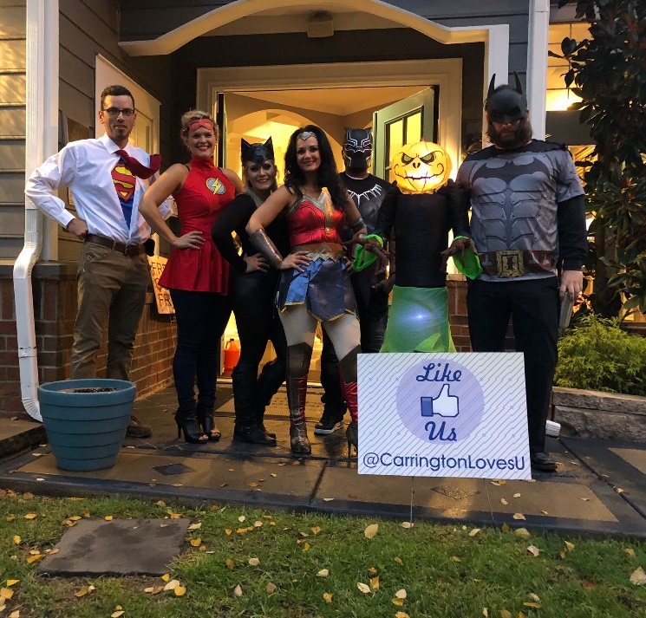
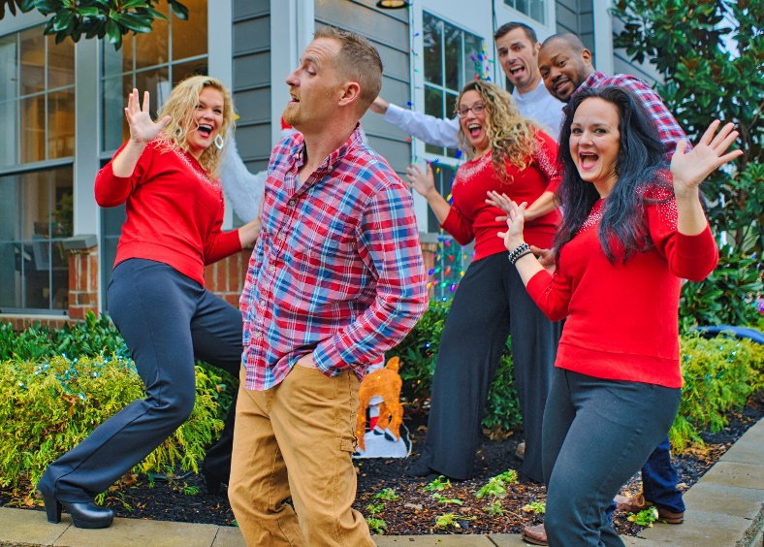
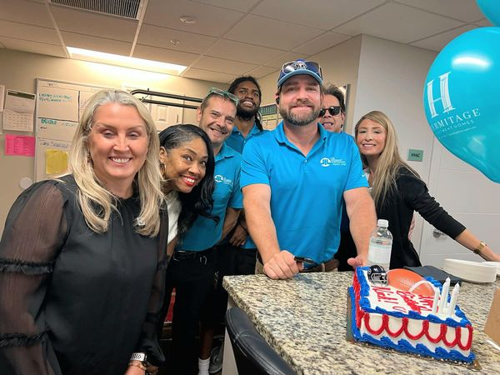
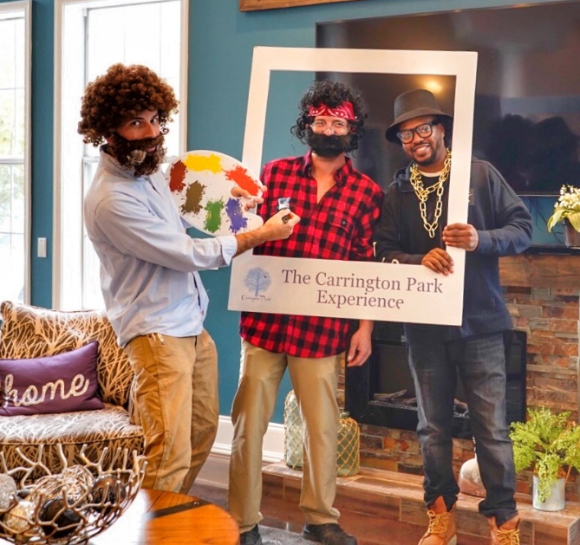
Happy
Teams!

Slide 11
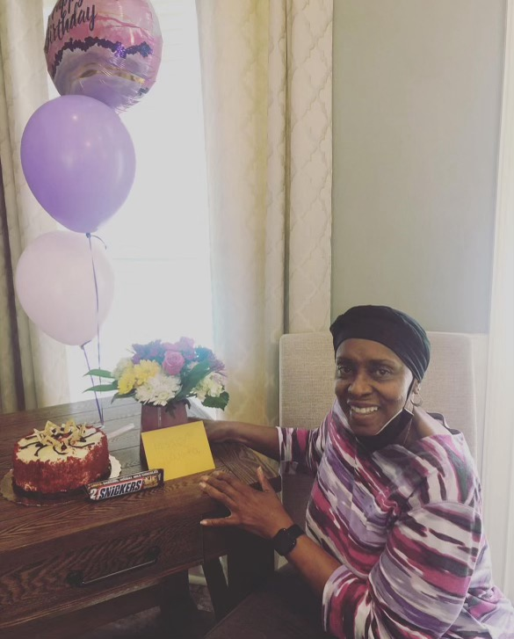
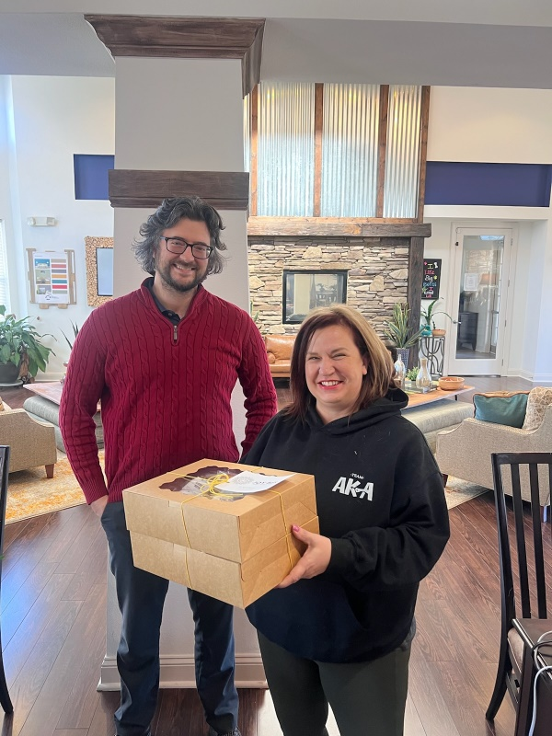
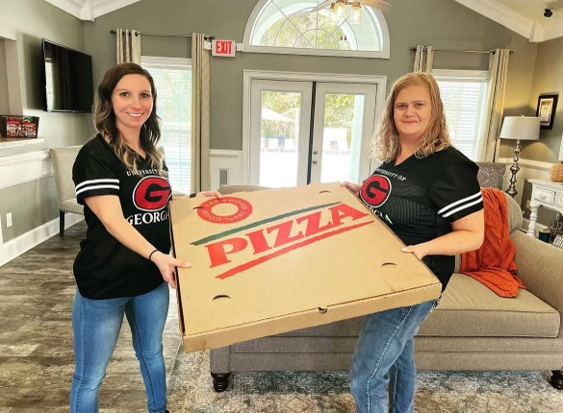
Resident Questionnaire…
- What do we do with this information?
- The quiet residents are not always “happy”
- How do we handle resident issues brought up in the Questionnaires?

Slide 12
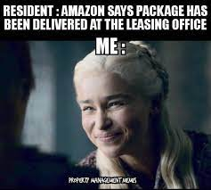
Outside of Work Orders, what have you taken from your Questionnaire and used at your own community to benefit residents as a whole?

Slide 13
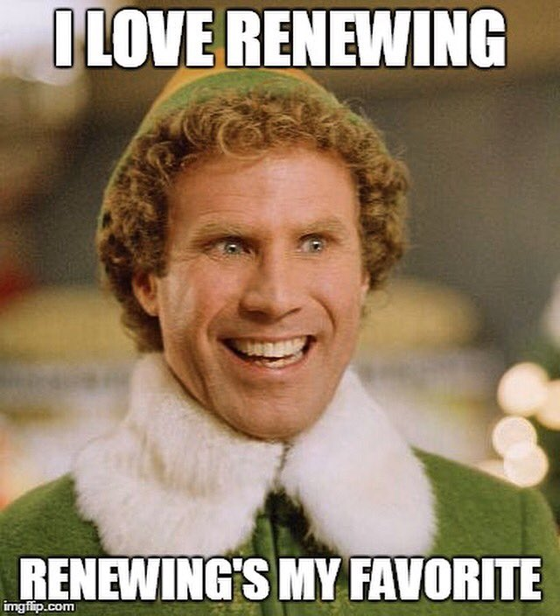
RENEWALS!!

Slide 14
Time to Role Play! ☺
How to Overcome Objections
During the Renewal Process
Break into groups of 4 (2 Maintenance, and 2 Office Staff)

Slide 15
SUMMIT
What are the two things
needed to hit the Summit?

Slide 16
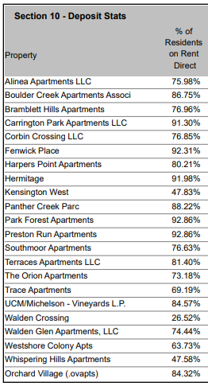
Top 3 Communities with more
Residents on ACH
Park Forest at 92.86%
Preston Run at 92.86%
Fenwick Place at 92.31%

Slide 17
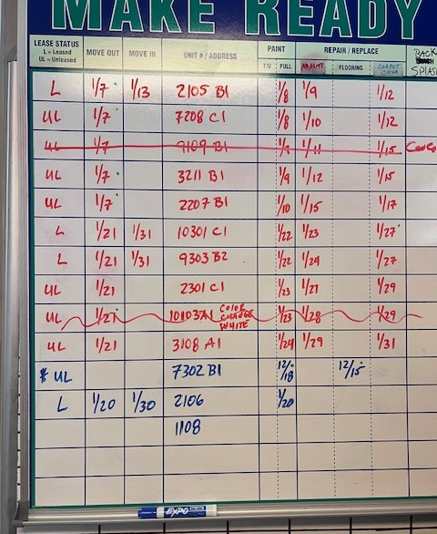
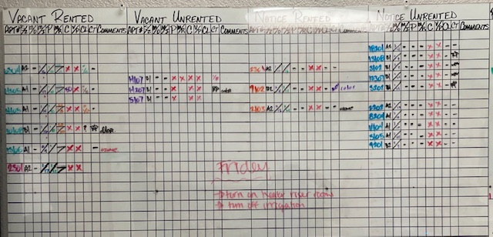
Make Ready Boards

Slide 18
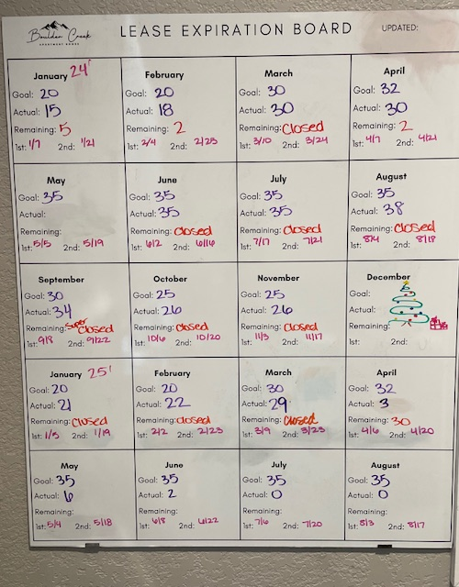
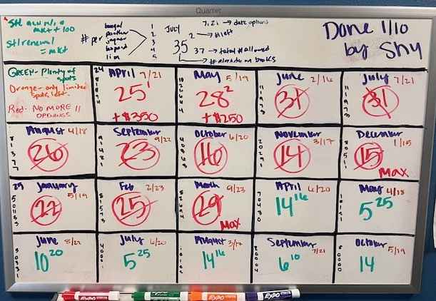
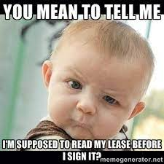
Lease Expiration Board/ Report

Slide 20
What is the average renewal % for Michelson in 2023?

Slide 21
What was the average increase for 2023?

Slide 22
What year was the super hero theme for conference?

Slide 23
What was the average concession given in 2023?

Slide 24
How many cups of coffee does Starbuck's serve annually?

Slide 25
Thank You for Your Participation!
See YOU at The TOP!

